Slide 1
UNIT-III
Statistical Quality Control

Slide 2
According to Terry Hill ‘quality is the concept that concerns how well and for, how long a product or service meets the requirements of a customer

Slide 3
Quality control
Quality control is the actual checking on completion of various tasks involved in the quality procedures ,which have been determined within the quality assurance function

Slide 4
Quality control functions:
To see that the product or service is designed according to the customer’s specification
To see that the product or service meet the safety conditions and is not harmful and injurious to customers
To see that the material , parts etc, are purchased of standard quality
To make the employees quality conscious

Slide 5
STATISTICAL QUALITY CONTROL (SQC)
The process of applying statistical principles to solve the problem of controlling the quality control of a product or service is called statistical quality control.
W.A. Shewart introduced, in 1931, the control charts on the basis of statistical principles. These are used to ensure quality.
Quality can be of two elements: (a) quality of design and (b) quality of conformance.
Quality of design refers to product features such as performance, reliability, durability, ease of use, serviceability, and so on.
Quality of conformance means whether the product meets the given quality specifications or not. In SQC, we are concerned with the quality of conformance.

Slide 6
SQC method can be useful:
To control the quality of products and quality of finished product during the manufacturing process
To decisions whether to accept or to reject a lot of finished products or the incoming materials
To provide information about the quality of the products manufactured in its factors to the management

Slide 7
Control charts
The control chart is a graphical representation of the result of inspection of a sample
Control charts were first developed by walter.A.Shewart in 1924
A control chart in general has three lines on graph paper
1.Central line: expected value of the static of a product
2.Upper control
3.Lower control

Slide 8
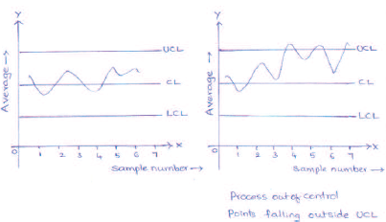

Slide 9
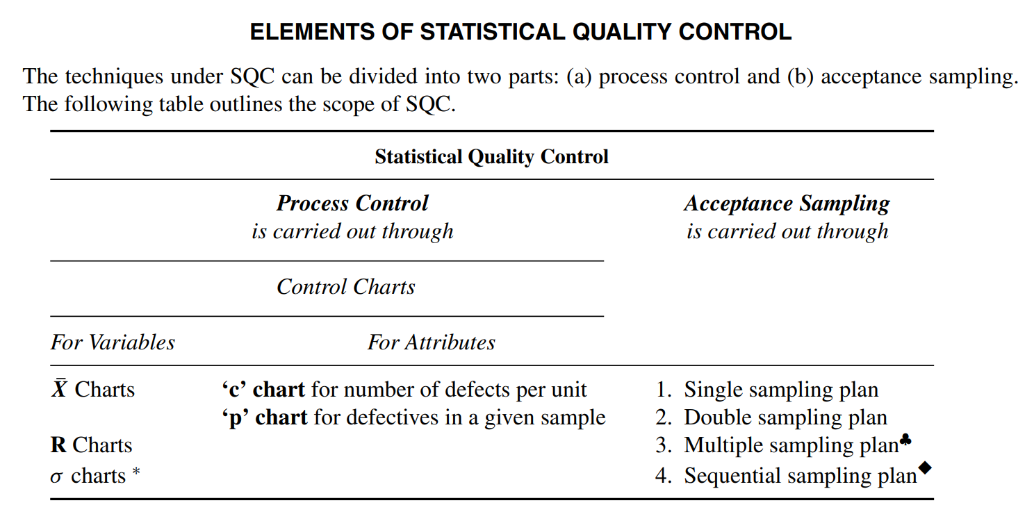

Slide 10
Types of control charts
There are two types of control charts. They are
Control charts for variables
The characteristics which can be measured are called variables
Control charts for attributes
The characteristics which are not measurable are called attributes. Control charts prepared to control the portion of defective units (p-charts) or the number of defects in a unit(c-chart)

Slide 11
Control Charts For Variables
A variable is one whose quality measurement changes from unit to unit.
The quality of these variables is measured in terms of hardness, thickness, length, and so on.

Slide 12
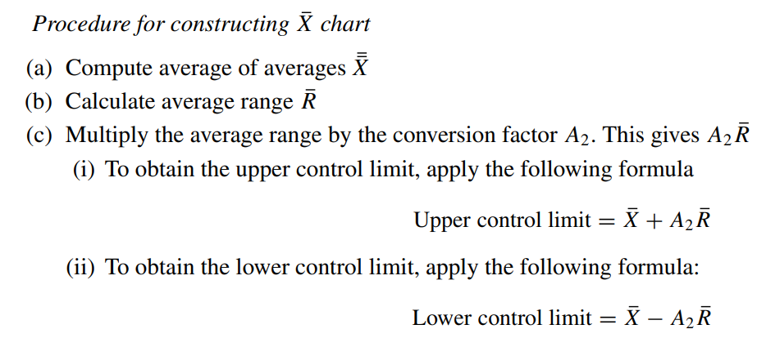
Procedure for constructing X chart

Slide 13
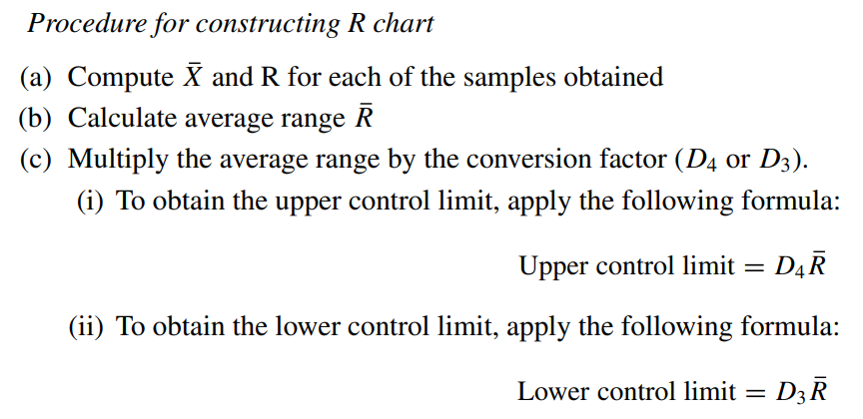
Procedure for constructing R chart

Slide 14
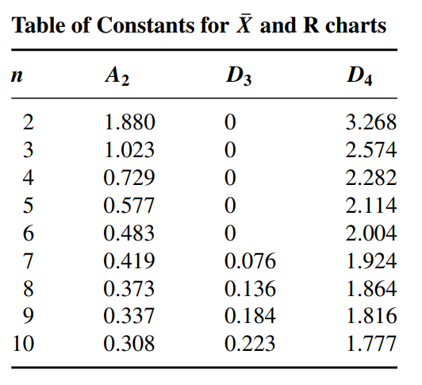

Slide 15
Interpretation of X chart and R chart
Keep the X chart and the R chart one above the other so that the average and range for any one subgroup are on the same vertical line.
If any of the subgroups display lack of control for that subgroup, it can be observed either in one or both the charts.
If all points fall within the control limits, it can be concluded that the process is free from the influence of assignable causes.
In case any of the points fall outside the control limits of X chart, it is an indication that there is a general change affecting the process after the first freak.
In such a case, it is better to study the operational details of the process and the workers’ feedback to identify the cause for such variation.

Slide 16
Typical causes of variation could be a tool wear, changes in temperature or vibration, defective raw materials, faulty equipment, untrained or inefficient production staff, improper machine settings, and so on.
If any of the points lie outside the control limits of R chart, it is an evidence that there is variability in the production process.
Whenever there is a change in personnel, increased variability of material, or excessive wear and tear in the process machinery, it is likely that uniformity of the process gets affected.
The R chart is so significant that it can warn even the impending machine accidents.

Slide 17
The X chart points out the causes for the variations between samples based on averages. X chart assumes that the process variation remains stable.
This chart helps to detect the shift of any degree in the production process. The R chart indicates causes for the variation within the sample.
It is likely that a sample with the same mean may not reveal a shift in the process at all. Hence, it is necessary to read both the X and the R chart together to decide whether the process is under control or not.
It is ideal to construct the R chart first and see if there is any significant variation including breakdown in the production process.
The X chart will be meaningful only when quality variation is brought to the minimum level.

Slide 18
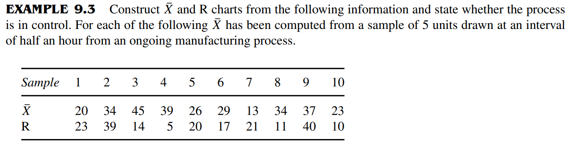

Slide 19
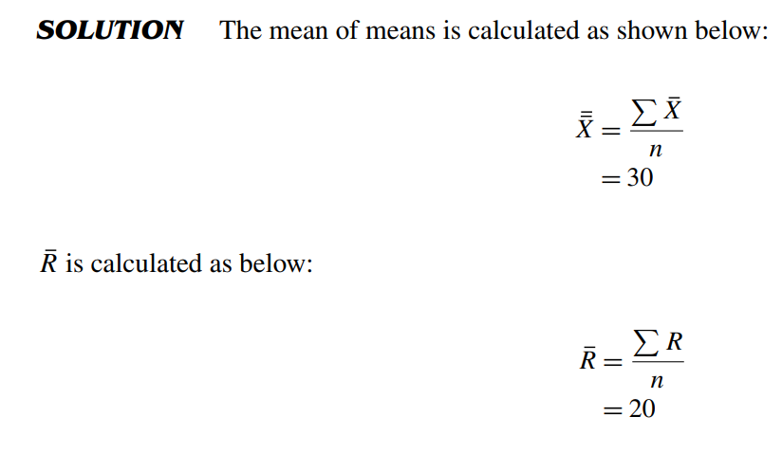

Slide 20
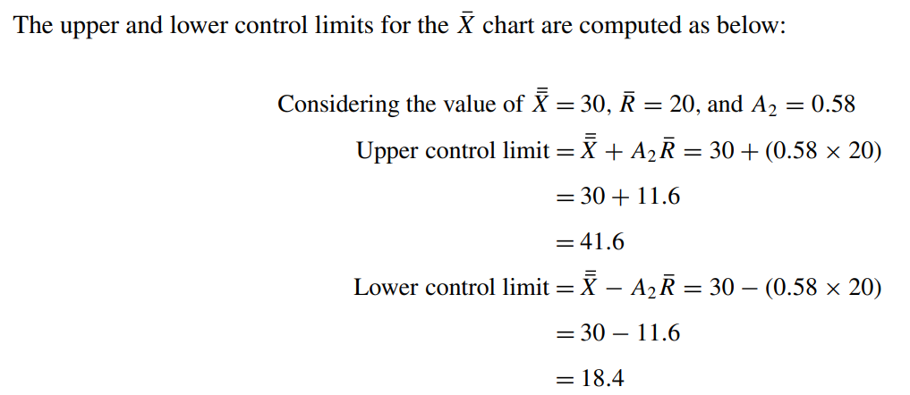
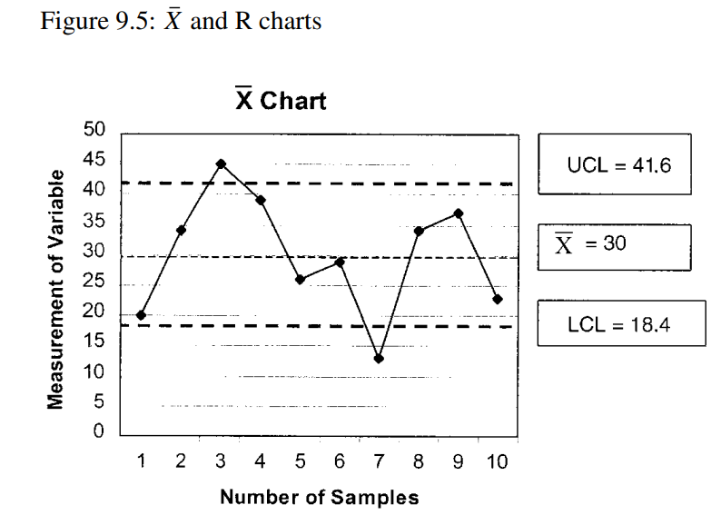

Slide 21
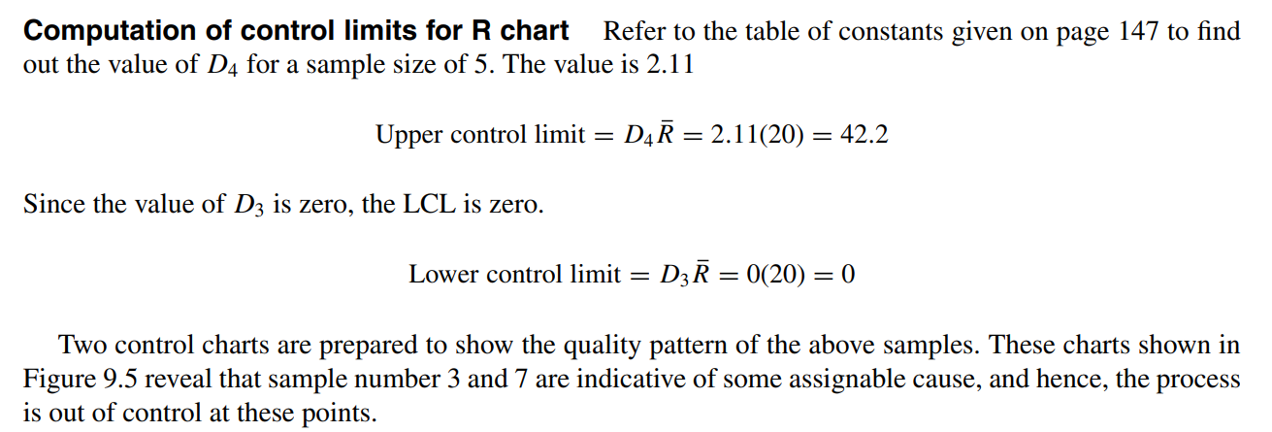
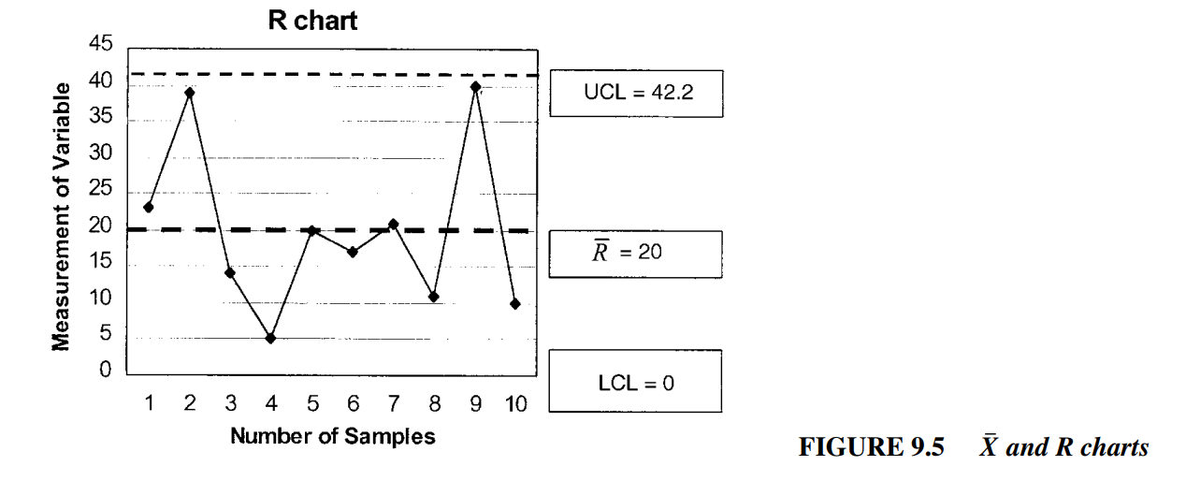

Slide 23
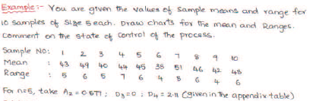

Slide 24
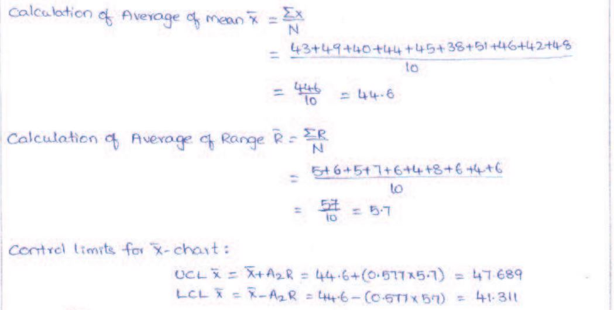

Slide 25
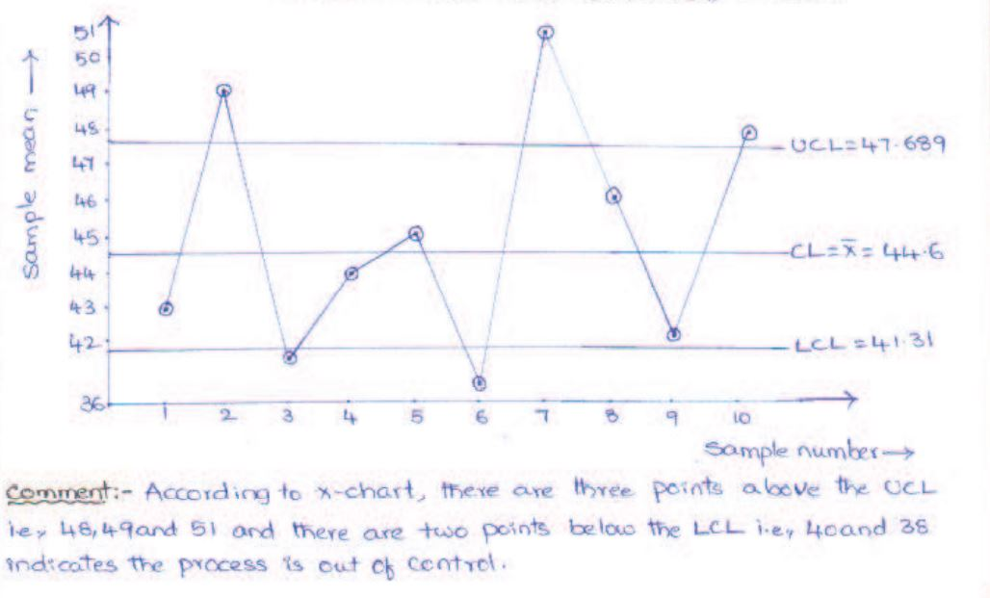

Slide 26
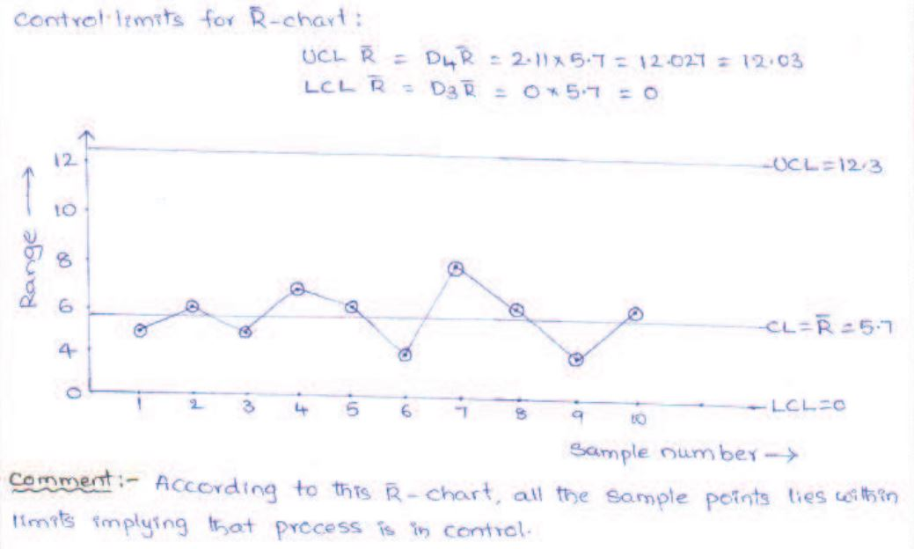

Slide 27
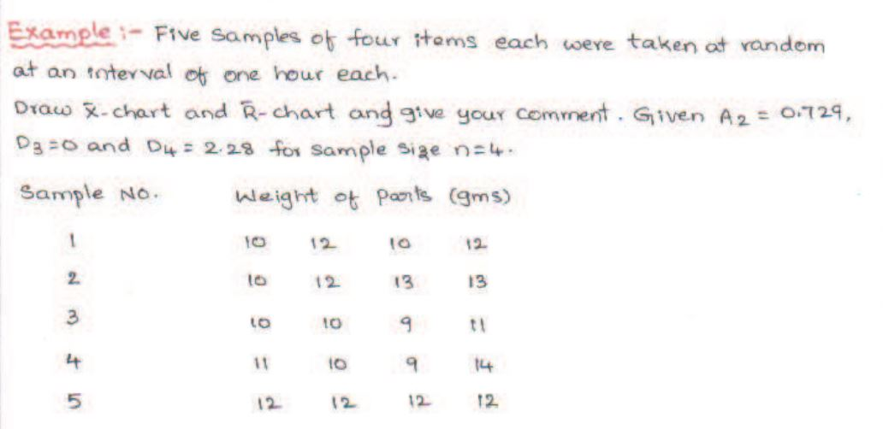

Slide 28
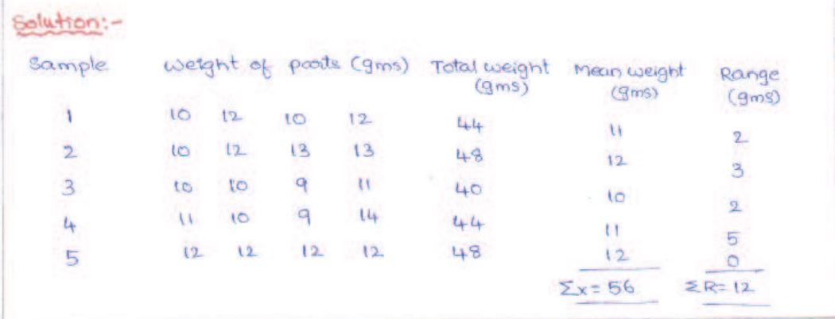

Slide 29
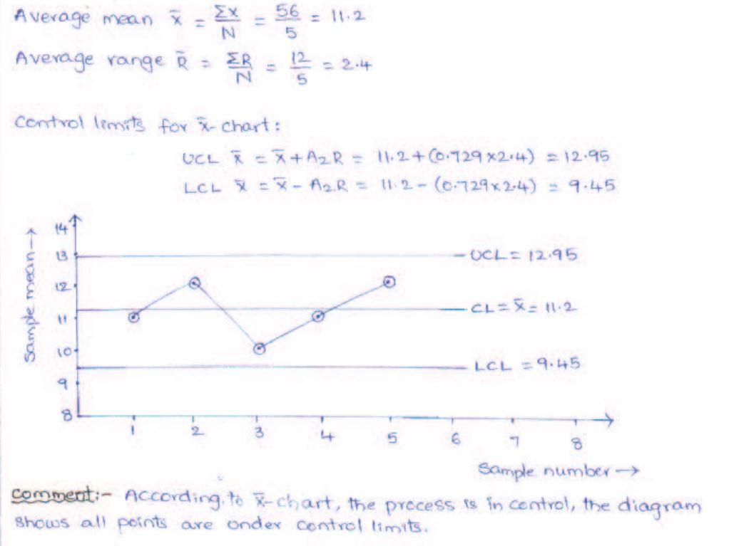

Slide 30
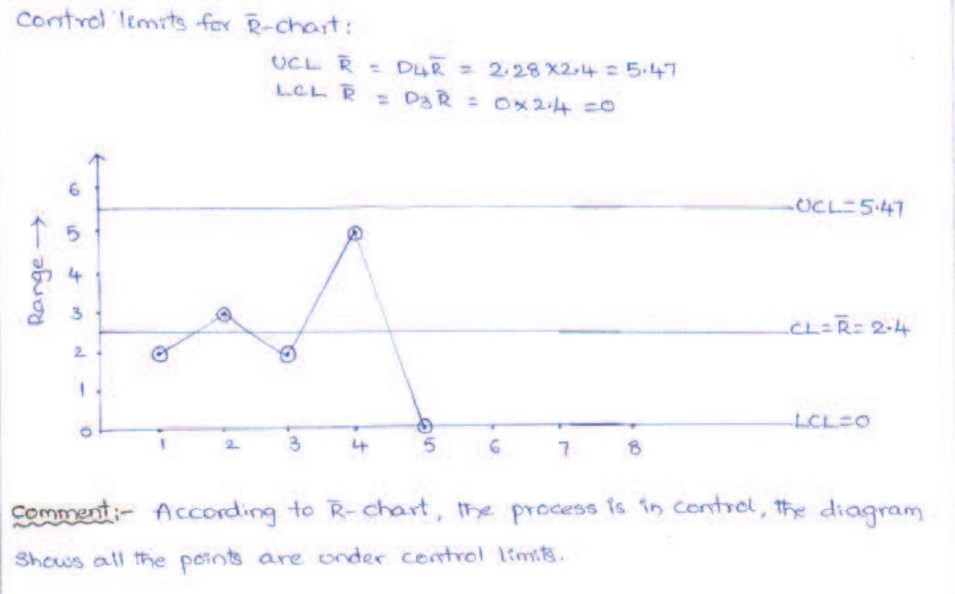

Slide 31
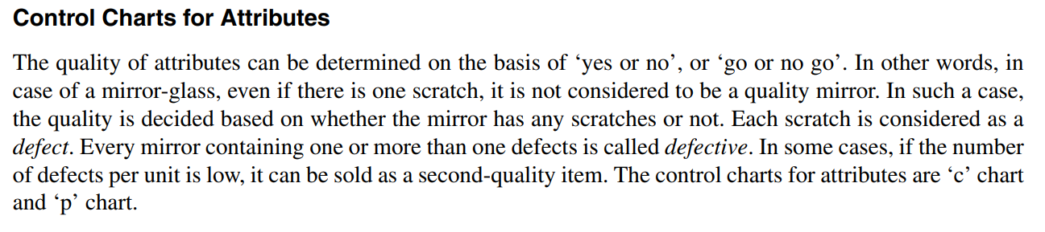

Slide 32
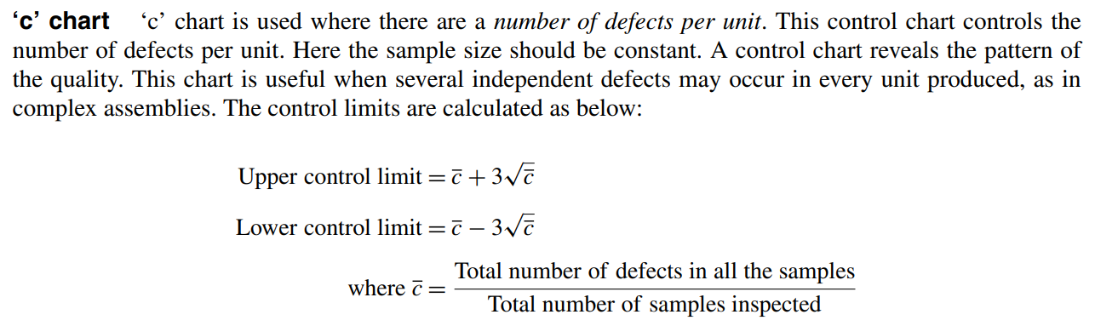
‘c’ chart

Slide 33
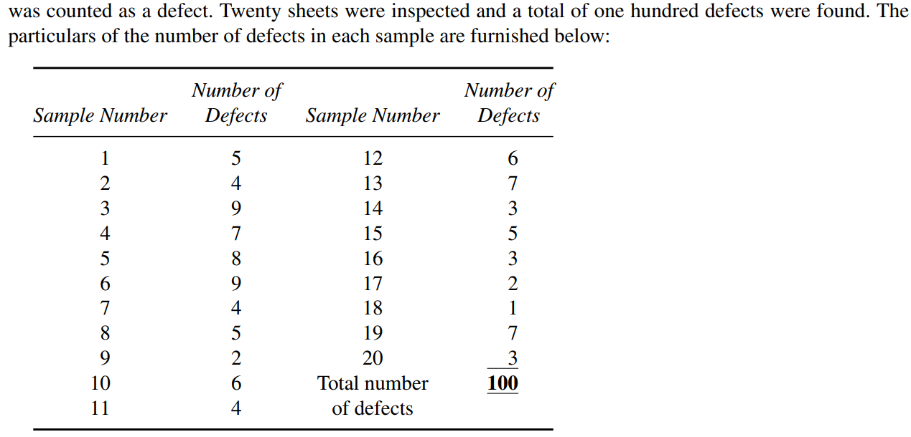

Slide 34
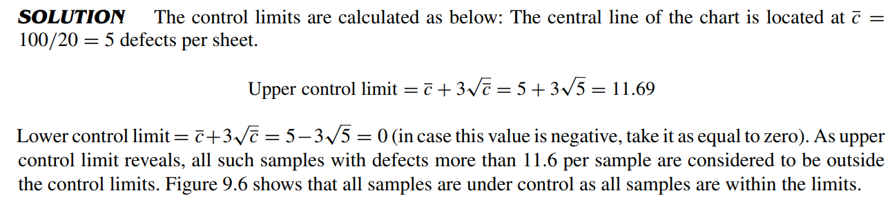
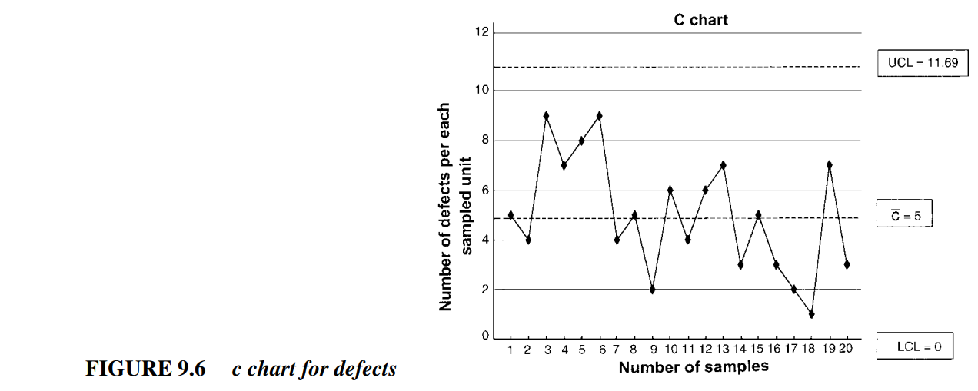

Slide 35
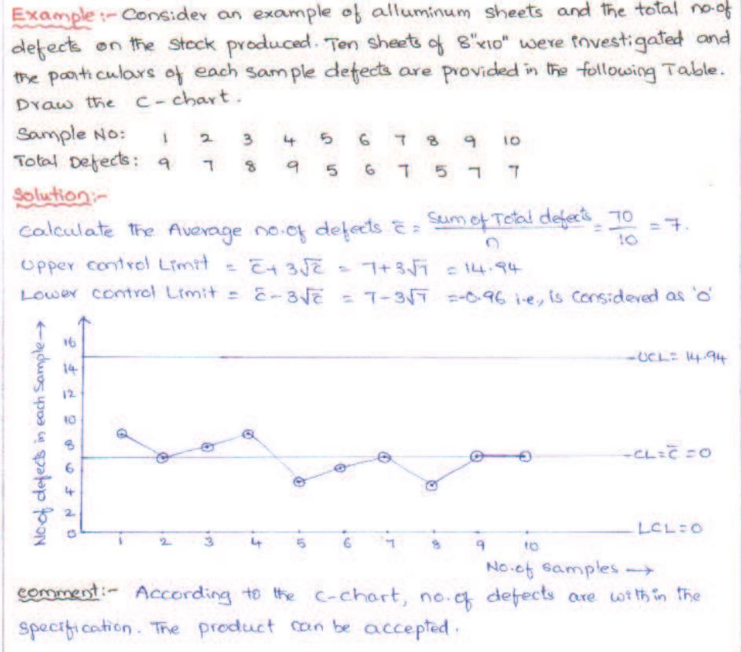

Slide 36
‘p’ chart
‘p’ chart is used where there is data about the number of defectives per sample.
It is also called fraction defective chart or percentage defective chart.
Here, each item is classified on ‘go or no go’ basis, that is, good or bad (defective).
Data collection costs and efforts are relatively less under this method.
Hence, if the sample size is larger, the results could be better.

Slide 37
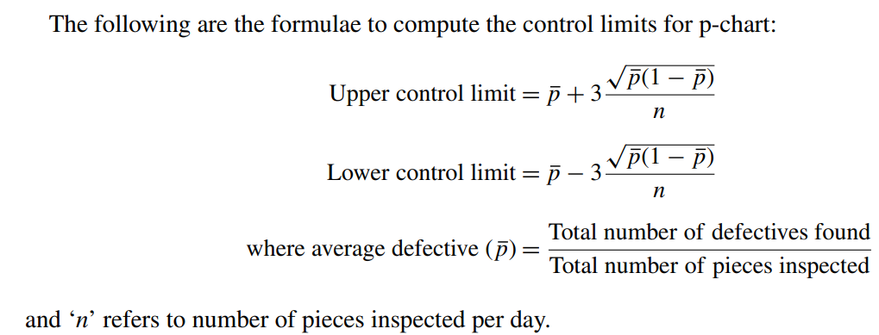

Slide 38
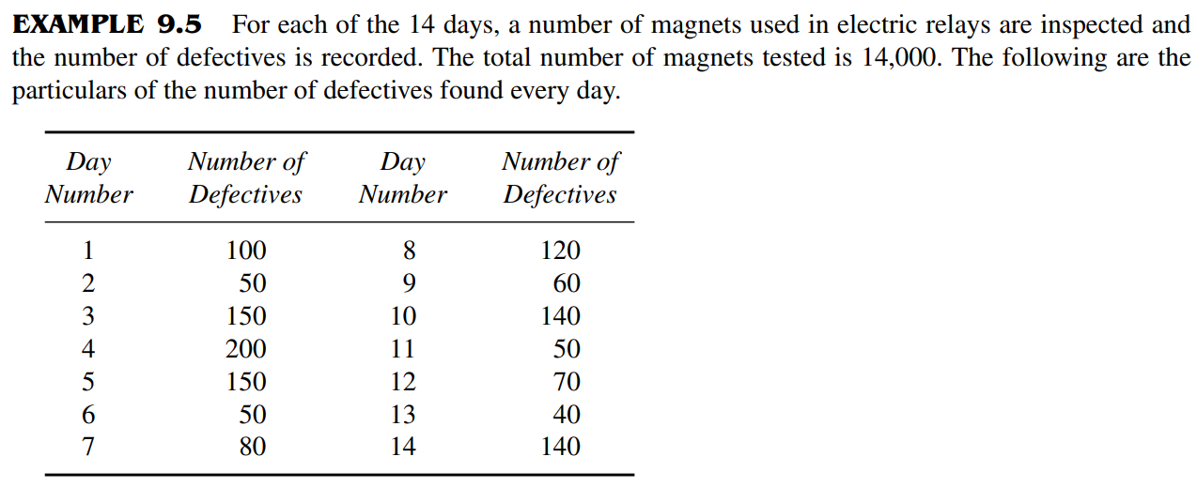

Slide 39
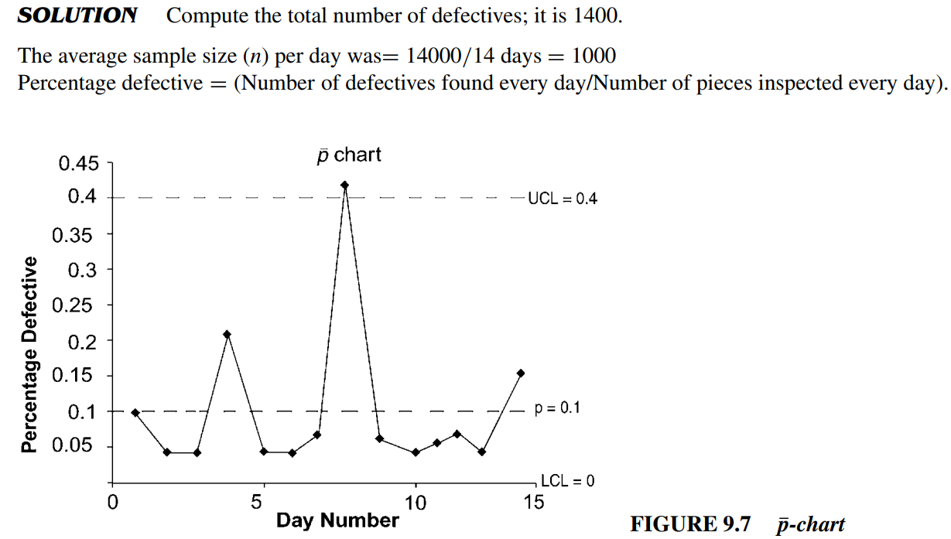
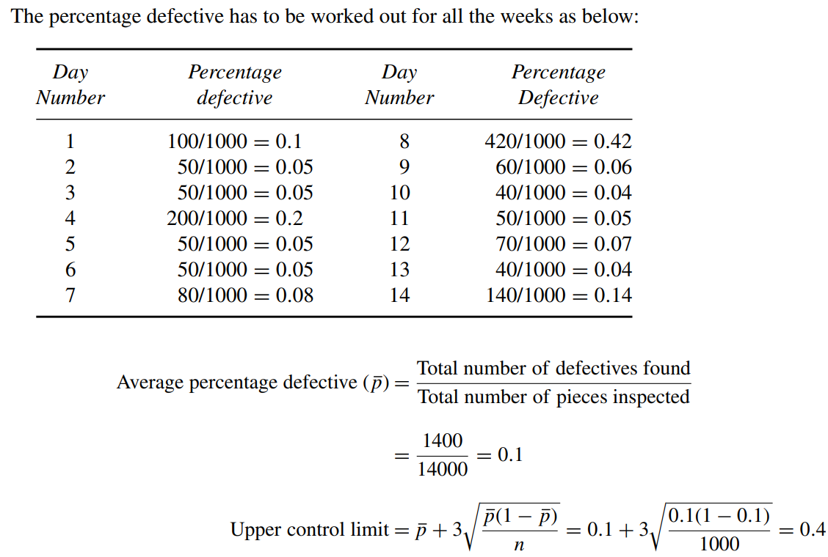

Slide 41
A close examination of all the percentage defectives from Figure 9.7 reveals that for the eighth day, the sample is above the upper control limit.
This indicates a significantly high percentage defective, which implies that there is an assignable cause on the manufacturing process.

Slide 42
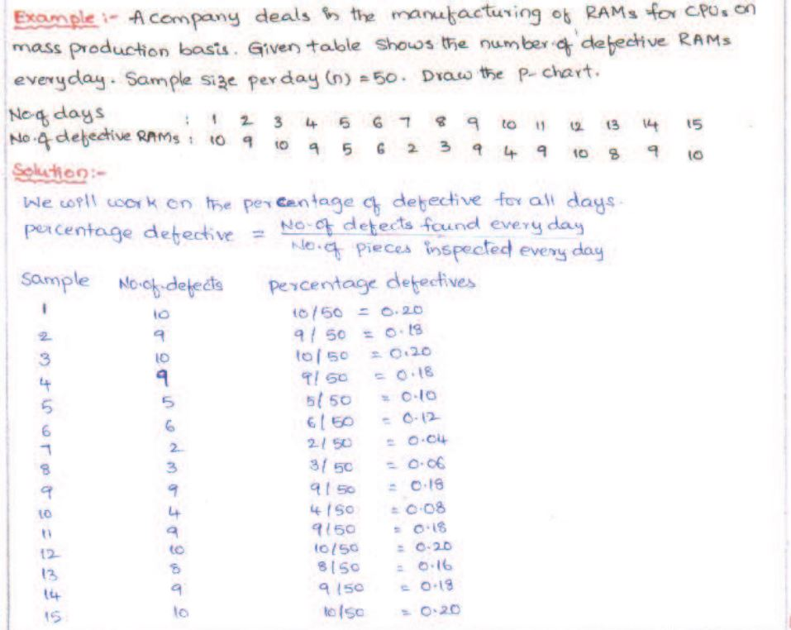

Slide 43
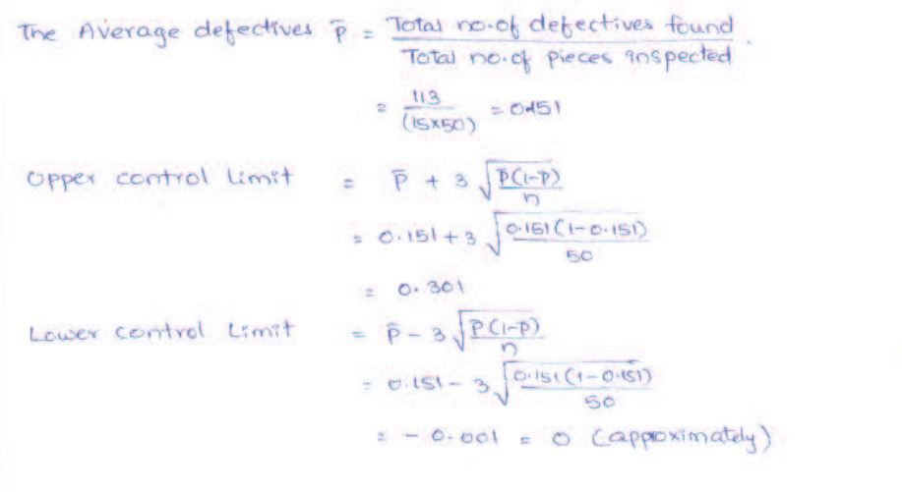

Slide 44
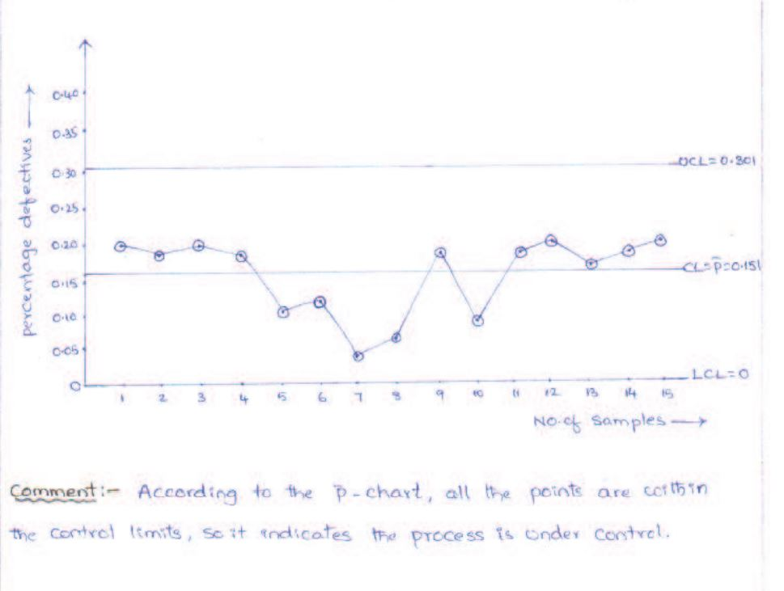

Slide 45
Acceptance Sampling
Acceptance sampling is a technique of deciding whether to accept the whole lot or not, based on the number of defectives from a randomly drawn sample.
It is the process of ensuring the quality of the products at the point of sale.
In other words, it is intended to guarantee the customer that the lot meant for sale does not contain defective products.
It is widely used in buying food products such as rice, wheat, and other agricultural produce.
Before buying, the random samples drawn from the bags of, say, rice or wheat, are tested.

Slide 46
If the quality of the samples drawn looks good or free from defects, then according to the requirement the entire bag or a part of it can be bought.
If the quality is not good, one would shift to another bag. In other words, the entire bag is rejected on the basis of the results of the samples drawn.

Slide 47
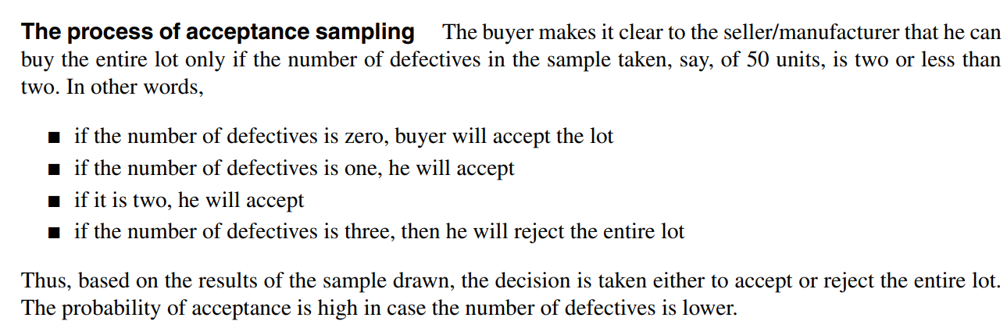

Slide 48
Sampling plans
Based on the number of samples drawn for taking accept/reject decisions, the sampling methods are used.
There are four methods of acceptance sampling:
Single sampling plan,
Double sampling plan,
Multiple sampling plan, and
Sequential sampling plan.
(Multiple and sequential sampling plans will be covered in the advanced courses on quality management.)

Slide 49
Single sampling plan
Here, decision is taken to accept or reject the entire lot on the basis of the results of only one sample.
If the number of defectives is less than the acceptance number then the entire lot is accepted. Otherwise, the entire lot is rejected.
To illustrate, if N = 1000, n = 50, and c = 3, the number of defectives from a random sample of 50 should be 0, 1, 2, or 3.
Then the entire lot of 1000 units can be accepted.
If the number of defectives exceeds three then the entire lot is rejected.

Slide 50
Evaluation:
This method is simple to operate.
However, the fact that the number of defectives in the sample selected is less does not mean that the entire lot is free from defectives.
If the number of defectives in the sample is more for any reason, it is detrimental to the producer.
Similarly, if the number of defectives in the sample is less and the remaining lot contains more defectives, it is a risk to the consumer.

Slide 51
Double Sampling Plan
This plan protects both producer and consumer from their respective risks.
Here, the decision to accept or not is based on the results of two randomly but successively drawn samples from the lot.
Figure 9.12 presents a schematic operation of double sampling plan.

Slide 52
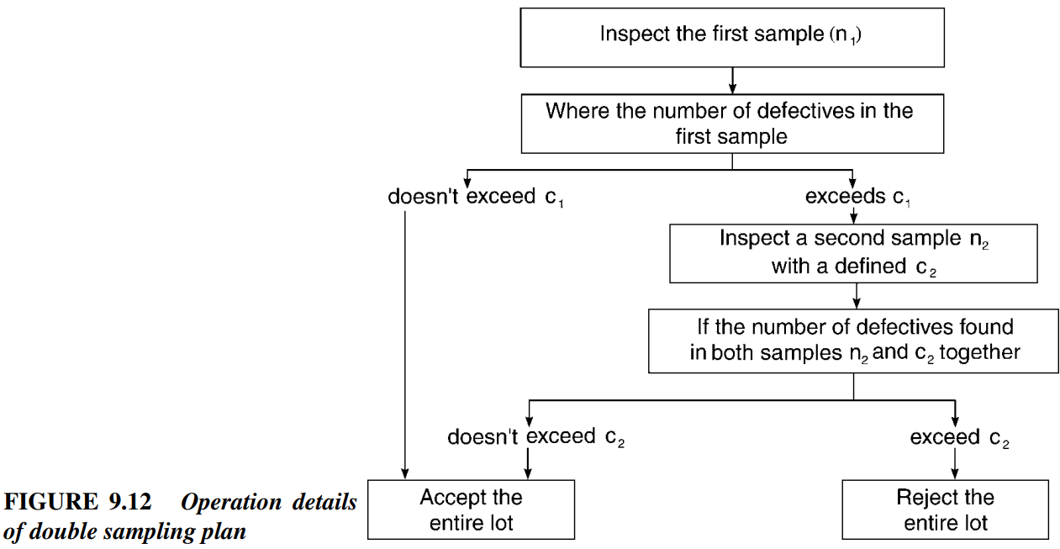

Slide 53
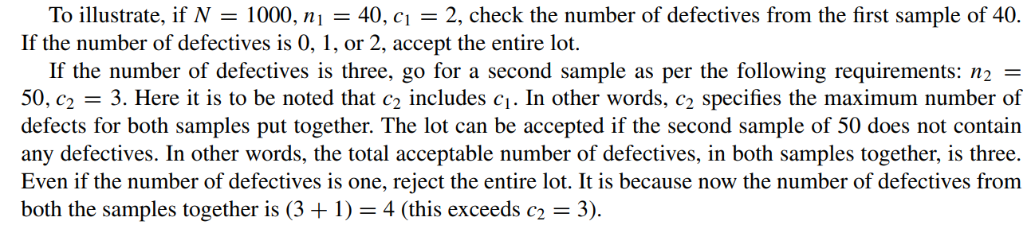

Slide 54
Evaluation:
The total amount of inspection required is less, because initial sample is smaller than that required by a comparable single sample plan.
It protects the interests of the producer by providing him another chance, particularly where the first sample shows up more number of defectives.
Thus, it protects the interests of the consumer also.

Slide 55
DEMING’S CONTRIBUTION TO QUALITY
William Edwards Deming was an American Professor widely credited with improving production in the United States during World War II.
He is best known for his work in Japan.
He taught the top management of organisations how to improve design (and thus service), product quality, testing and sales (the last through global markets) through various statistical methods.
Deming contributed significantly to Japan becoming renowned for producing innovative high-quality products and becoming an economic power.

Slide 56
A number of Japanese manufacturers applied his techniques widely and achieved previously unheard of levels of quality and productivity.
The improved quality combined with the lowered cost created new international demand for Japanese products.
Deming taught that by adopting appropriate principles of management, organizations can increase quality and simultaneously reduce costs (by reducing waste, rework, staff attrition and litigation while increasing customer loyalty).
The key is to practice continual improvement and think of manufacturing as a system, not as bits and pieces.
In the name of Deming, an award called the Deming Prize was established, which is given to companies which show great quality in their products and services.
TVS Group has been one of the corporates that bagged the Deming Prize for their quality!

Slide 57
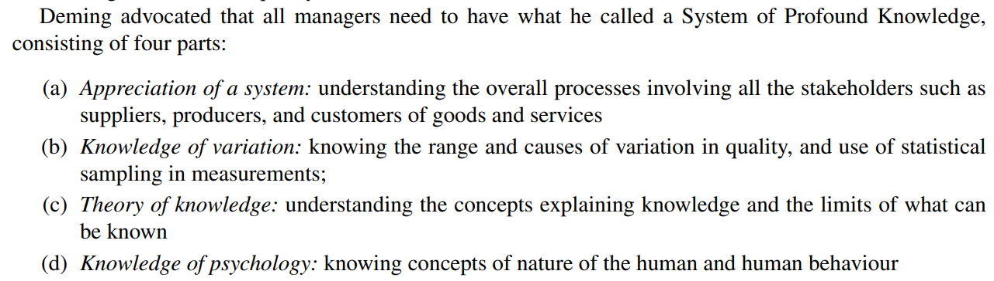

Slide 58
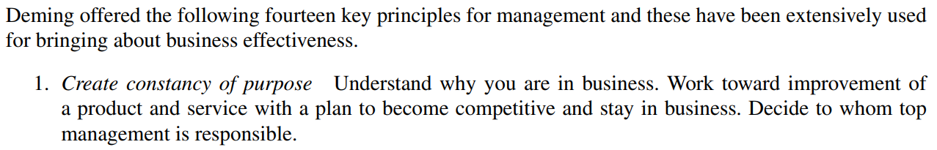
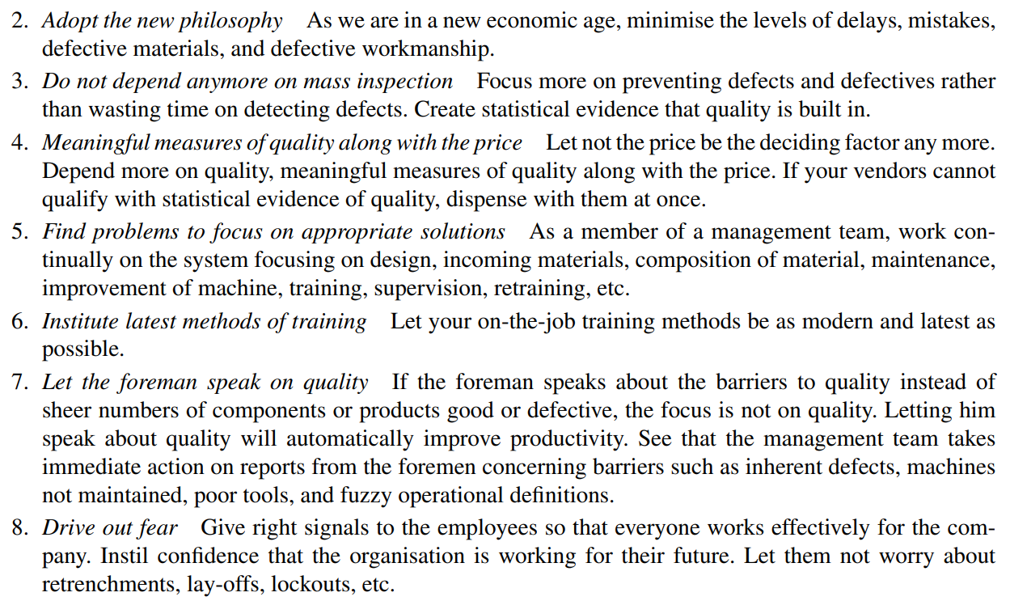
Deming’s 14 points

Slide 60
